Slide 1

Food Distribution Program
Getting Started in WBSCM Part II: Training Portal
Texas Department of Agriculture
USDA Division

Slide 2
Acknowledgement Statement
You understand and acknowledge that:
The training you are about to take does not cover the entire scope of the program; and that
You are responsible for knowing and understanding all handbooks, manuals, alerts, notices, and guidance, as well as any other forms of communication that provide further guidance, clarification, or instruction on operating the program.

Slide 3


01
Introduction
Course Objectives and Outcomes.
02
Training Environment Log-In and Portal Components
Logging in to WBSCM training environment view.
03
Help Features
Help Module Tab and Job Aid Pop Up Features
04
WBSCM Getting Started Course Outline
Accessibility Settings
Setting up Accessibility Features

Slide 4

TX-UNPS to WBSCM Terms and Acronyms
TX-UNPS | Web-Based Supply Chain Management (WBSCM)
Contracting Entity (CE) | Recipient Agency (RA)
Texas Department of Agriculture (TDA) | State Distributing Agency (SDA)
Operations | Transactions
Survey | Catalog

Slide 5

02
Training Portal Log-In and Components
Portal Components and Functionality
Notes:
Follow the directions on the next sets of slides to log into the training environment and orient users to the different functions and features available

Slide 6
Training Portal Log-In
ESCs and RA Users Log In To WBSCM Training Environment
URL: wbscmntrn.wbscm.usda.gov
RA Training Environment Username and Password previously provided via e-mail.
Note the "ntrn" section of the web address. This indicates the training environment.
Notes:
Highlight the difference between training environment vs. Production URLs.
Production environment does not have the "ntrn" component in the web address.
Logins previously provided via to RAs for training environment
Log in to training environment will be different from login to username for live system which occurs after all required training is complete.

Slide 7
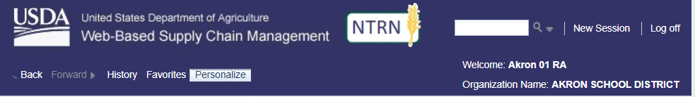
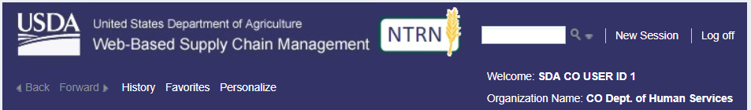
Training Portal Log-In
RA Training Environment View
NTRN icon signals training environment.
User and Organization Name
ESC Training Environment View
NTRN icon signals training environment.
User and Organization Name
Notes:
User name and organization will show different user roles. Differences in navigation panels will be determined based on roles/level of access.

Slide 8
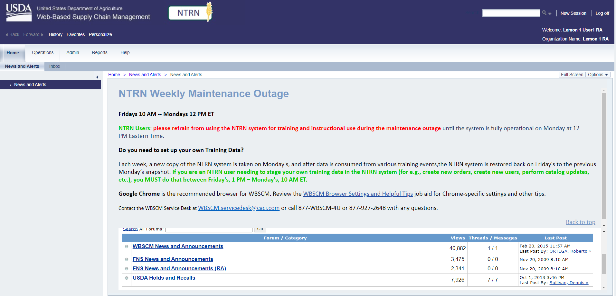
Check for New Content
Check Forum for updates.
Notes:
Highlight the importance of checking announcements on splash page.

Slide 9
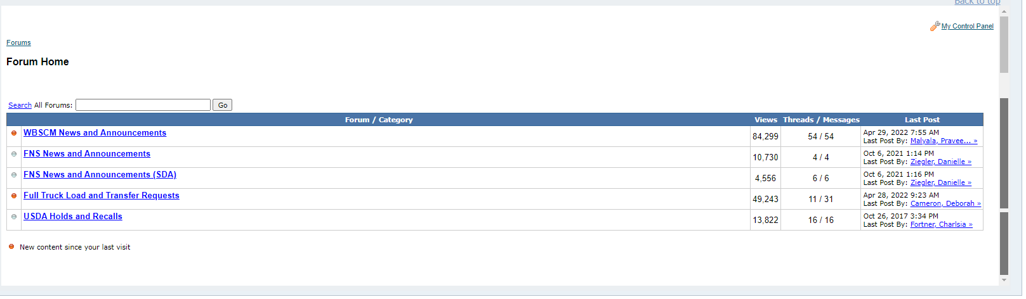
Check for New Content
Announcements with orange dots are new.
Scroll to see all announcements

Slide 10
WBSCM Portal Screen Components
Log in name in upper right-hand corner
Notes:
RA User Administrator will have capability to create multiple user role staff log-in users.

Slide 11
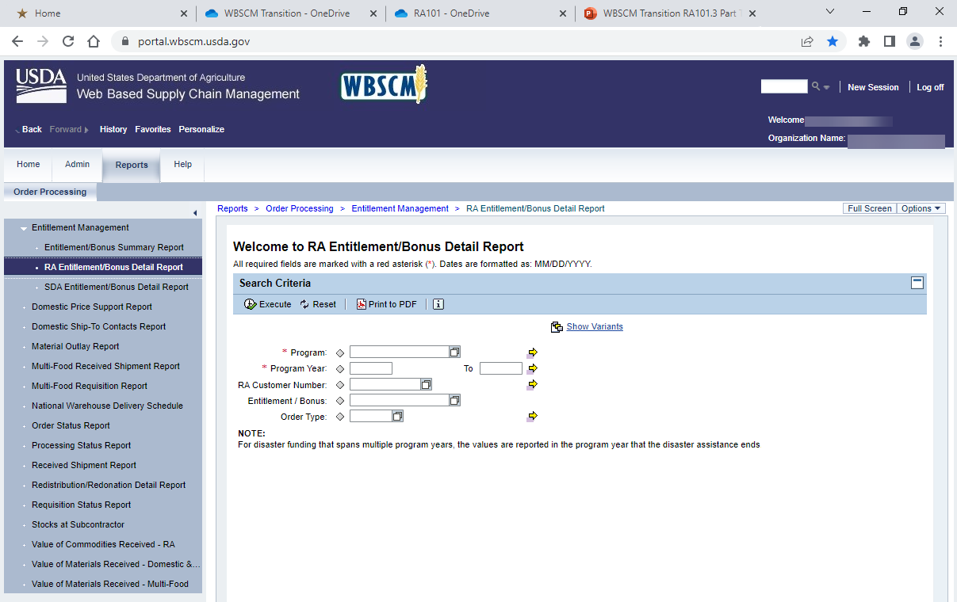
WBSCM Portal Screen Components
1
1. Search bar:
  Used to search transactions

Slide 12
WBSCM Portal Screen Components
2
2. Level 1 Module Tabs: (Level 1 options here)
  Provide highest level of navigation
  Tabs available depend on the user’s roles in WBSCM.

Slide 13
WBSCM Portal Screen Components
3
3. Level 2 Tabs:
  Sub-menu options for level 2.

Slide 14
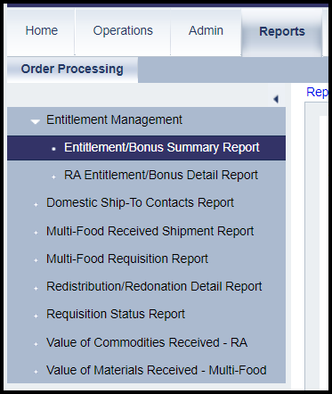
WBSCM Portal Screen Components
4. Detailed Navigation Panel:
  WBSCM transactions. Contents from Level 2-tab selection and the user’s roles in WBSCM.
Level 2 Tab
4
Detailed Navigation Panel

Slide 15
WBSCM Portal Screen Components
5
5. Content area:
  Used to enter or view details and execute transactions.

Slide 16
03
WBSCM
Help Features
Notes:
Follow the directions on the next sets of slides to access Help Features

Slide 17
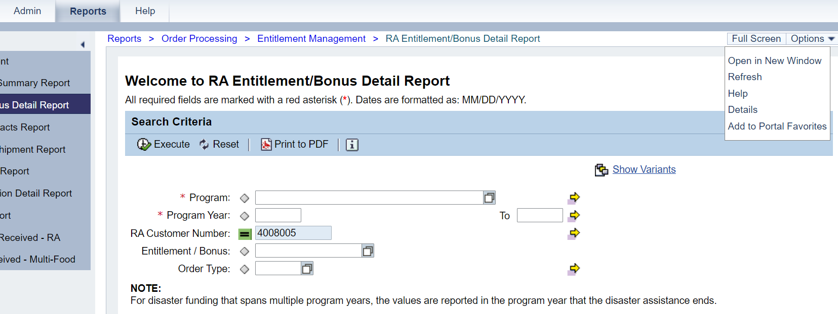
WBSCM Help Features
1
Two Ways To Access Help Features:
Help Module Tab
Options Dropdown
  Help
2

Slide 18
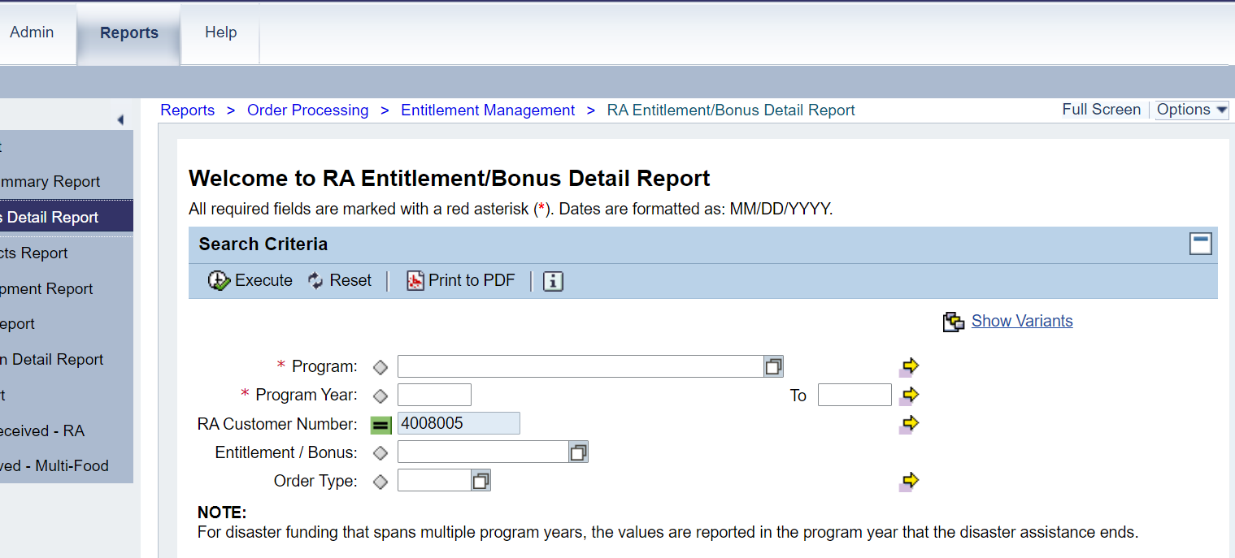
WBSCM Help Features
1
Option 1:
Click the Help Module Tab

Slide 19
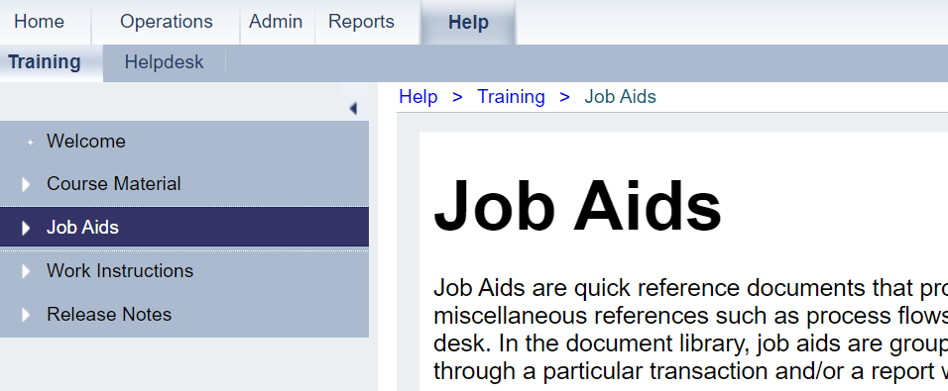
WBSCM Help Features
Training Navigation Panel Includes:
Course Material Modules
Job Aids
Work Instructions
Release Notes

Slide 20
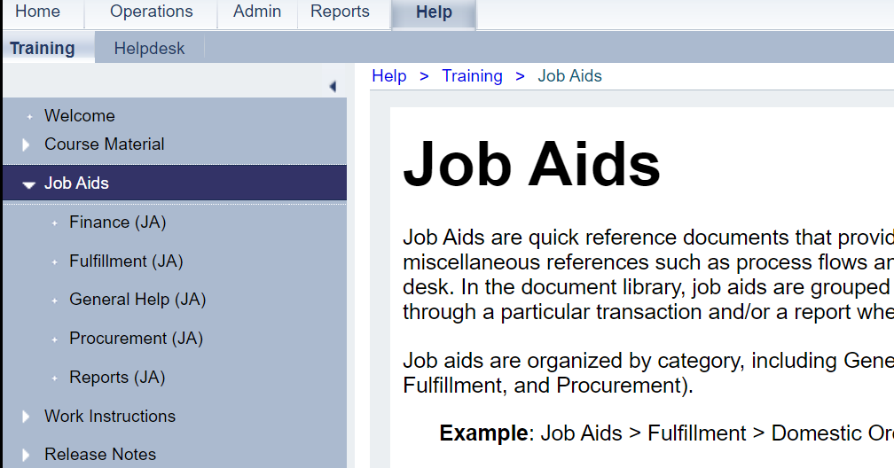
WBSCM Help Features
Click Arrows to Access Help Resources by Topic

Slide 21
WBSCM Help Features
Option 2:
Access Help through Options Dropdown
2

Slide 22
WBSCM Help Features
Click Options Dropdown

Slide 23
WBSCM Help Features
Click Help

Slide 24
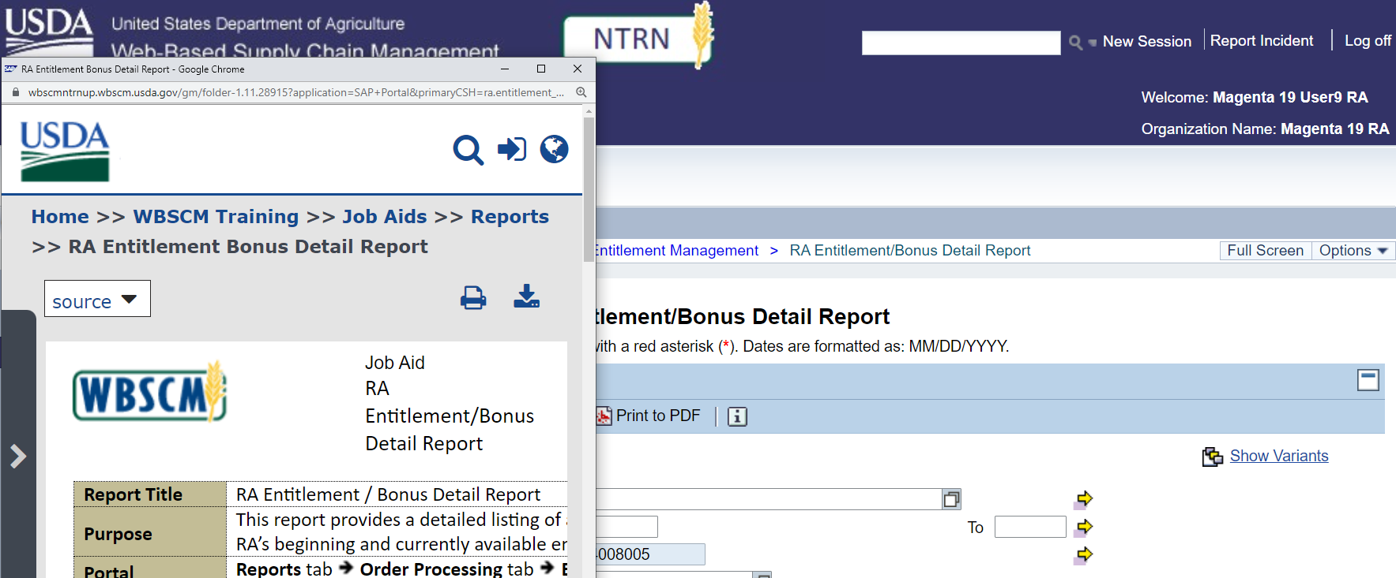
WBSCM Help Features
Job Aid Pop Up Appears
After Choosing “Help” from “Options” Dropdown
Notes:
Job Aids and Work Instructions Pop Up Documents Appear after selecting Help.
Job Aids and Work Instructions Will be specific to the transaction the user is currently working on in the Main Content Area

Slide 25
WBSCM Help Features
Job Aid Pop Ups are specific to transactions users are working on in the Main Content Area
Notes:
Job Aid Pop Up Documents Appear after selecting Help.
Job Aid Pop Ups are specific to transactions users are working on in the Main Content Area

Slide 26
04
Setting Up Accessibility Options
Notes:
Not all users will need to enable Accessibility Settings. However, by moving through this process with the group, those who need this feature will not have to independently request this access and divulge personal information.
Follow the directions on the next slides to enable Accessibility Settings

Slide 27
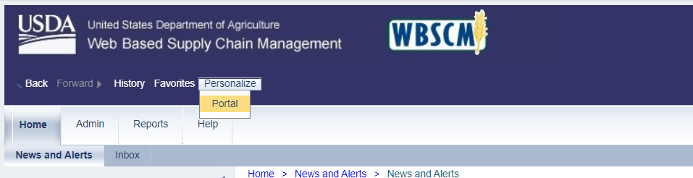
Set Up Accessibility in WBSCM
Once activated, users can:
Navigate using hot keys associated with preferred screen reader.
Access detailed tooltips and instruction boxes.
Access updates as accessibility guidelines change and new methods of conformance are available.
1
1. Click on “Personalize tab” then
2. Click “Portal” from the drop-down menu
2
Notes:
Not all users will need to enable Accessibility Settings. However, by moving through this process with the group, those who need this feature will not have to independently request this access and divulge personal information.
Click Personalize
Click Portal from drop down menu

Slide 28
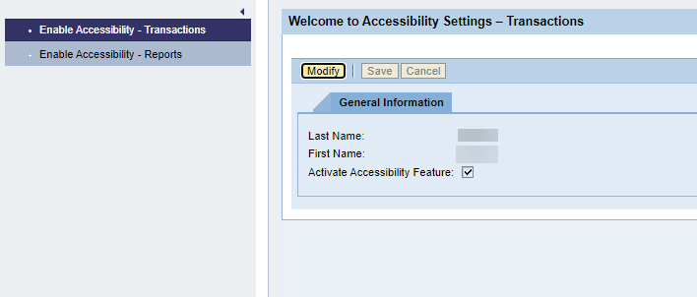
Set Up Accessibility in WBSCM
3
Click Modify
Notes:
Enable Accessibility Pop-Up Box will appear. Note that enabling accessibility for TRANSACTIONS is highlighted first. The same process will need to be repeated to enable accessibility options for Reports. (See detailed navigation panel)
Click modify box in accessibility features to allow checkbox activation for “Activate Accessibility Feature”

Slide 29
Set Up Accessibility in WBSCM
Click Activate Accessibility Feature
4

Slide 30
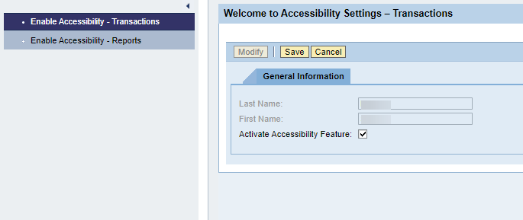
Set Up Accessibility in WBSCM
5
Click Save

Slide 31
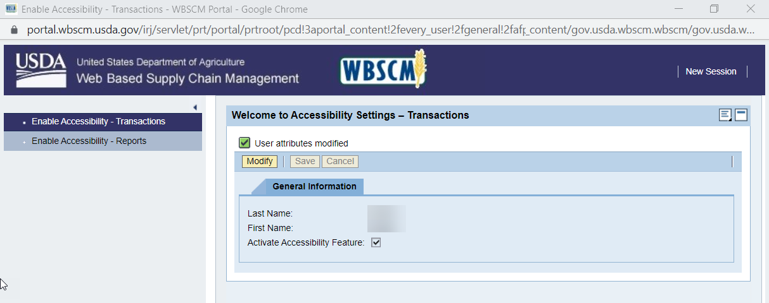
Set Up Accessibility in WBSCM
User Attributes Modified message will appear.
6

Slide 32
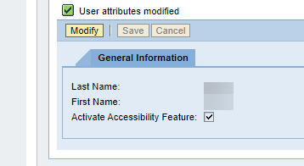
Set Up Accessibility in WBSCM
WBSCM displays the message, “User attributes modified.”
Note: If system displays “No extension entered” warning message, user may disregard.
Accessibility feature must be turned on separately for transactions and reports
Repeat steps 1 – 6 for the Enable Accessibility - Reports option in the Detailed Navigation Panel.

Slide 33
Set Up Accessibility in WBSCM
Click the Close button to the pop-up to close the transaction.
Refresh the browser after returning to WBSCM portal to apply changes

Slide 34


34
KNOWLEDGE
CHECK
Notes:
Users will submit responses to Knowledge Check via QR Code

Slide 35
Getting Started Knowledge Check
Must Complete To Receive Training Credit

Slide 36
WBSCM Portal Navigation Knowledge Check
Question:
WBSCM Navigation Panels list RA (Recipient Agency) Entitlement as a transaction option. RA is the WBSCM acronym that is used in place of what TX-UNPS acronym/term?
A. TDA (Texas Department of Agriculture)
B. CE (Contracting Entity)
C. SDA (State Distributing Agency)
A
B
C
Notes:
QR Code on following slide to submit responses

Slide 37

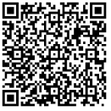
Knowledge Check:
Scan QR Code or visit the Link below to access the Knowledge Check
https://bit.ly/3pE5Tce

Slide 38
Getting Started Knowledge Check
A
A. TDA (Texas Department of Agriculture)
In WBSCM, SDA (or State Distributing Agency) refers to TDA.
Notes:
Review answer choice explanation with RAs

Slide 39

Getting Started Knowledge Check
A
A. TDA (Texas Department of Agriculture)
In WBSCM, SDA (or State Distributing Agency) refers to TDA.

Slide 40
Getting Started Knowledge Check
B
B. CE (Contracting Entity)
In WBSCM, RA (or Recipient Agency) takes place of what was previously referred to as CE, or Contracting Entity.

Slide 41

Getting Started Knowledge Check
B
B. CE (Contracting Entity)
In WBSCM, RA (or Recipient Agency) takes place of what was previously referred to as CE, or Contracting Entity.

Slide 42
Getting Started Knowledge Check
C
C. SDA (State Distributing Agency)
In WBSCM, State Distributing Agency is the term used for TDA, or Texas Department of Agriculture

Slide 43
Getting Started Knowledge Check
C
C. SDA (State Distributing Agency)
In WBSCM, State Distributing Agency is the term used for TDA, or Texas Department of Agriculture

Slide 44

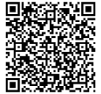
RA User Needs and Concerns
Scan the QR Code to share your needs/concerns or click on the link below.
https://bit.ly/3NzHCM2
Notes:
Image: https://www.goodtherapy.org/admin/includes/ckfinder/userfiles/images/counselor-listens-to-client.jpg

Slide 45

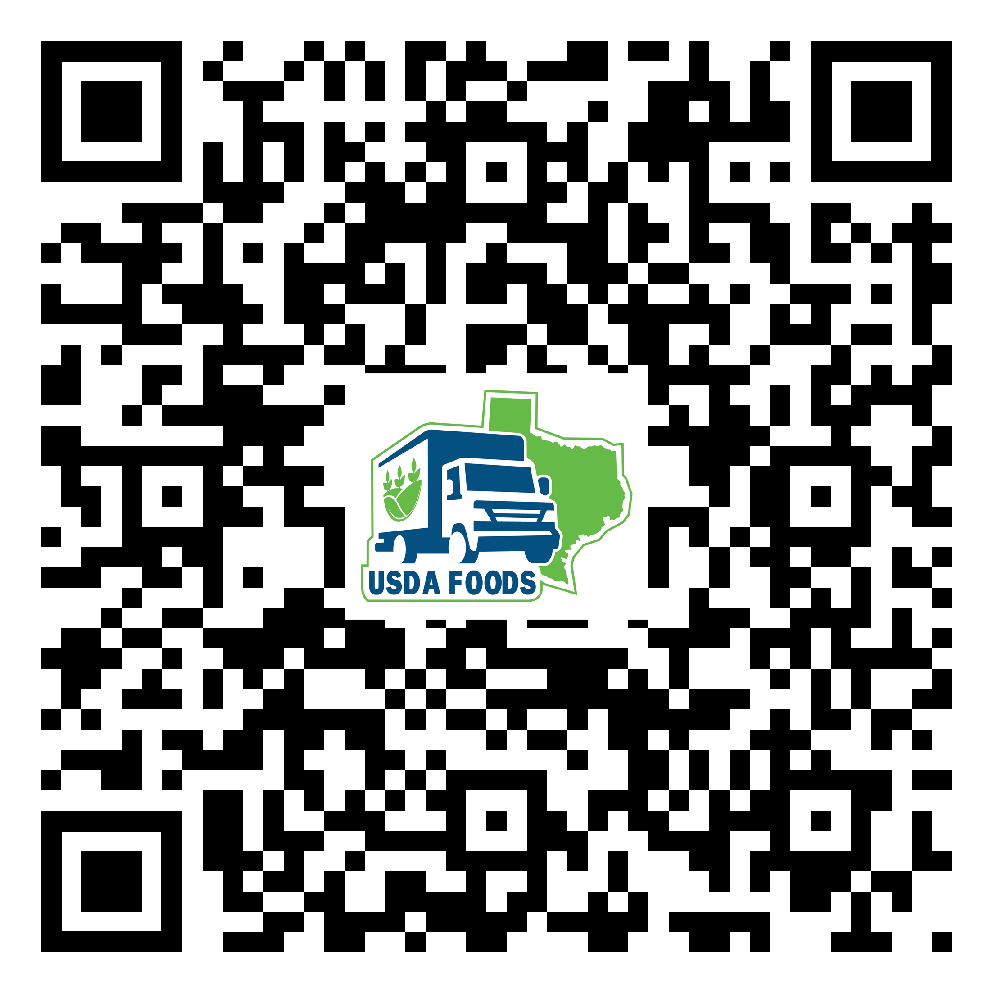
For WBSCM Assistance
See Contact Information Section on WBSCM Transition Page

Slide 46

Questions?

Slide 47
WBSCM Transition Page QR Code:
Scan QR Code to visit the Food Distribution Program WBSCM Transition website
Notes:
TRAINER NOTE:
May hide this slide if desired and/or training multiple modules at once.

Slide 48

Break (3 minutes)
Notes:
TRAINER NOTE:
Hide if not needed/desired. If training multiple modules at once, can use as a timer for those needing a quick break.
Play straight from slide. If selecting to play from YouTube, ads may appear, and designated start and stop times will not be saved.

Slide 49

Lab Time:

Slide 51
Contact Us
https://squaremeals.org/Programs/FDPWBSCMTransitionProject.aspx
Contact Your Education Service Center

